Slide 1




COLUMNS
CME1252 PBL – III. Project
Prepared by:
Gürkan Bıyık
Duru Çapar
Deniz Katayıfçı
Şahin Öztürk
Lecturers
Assoc. Dr. Derya Birant
Ress. Asst. Göksu Tüysüzoğlu
27.05.2022
IZMIR

Slide 2

Outline
INTRODUCTION
PROGRESS SUMMARY
Requirements
Task Sharing
Scheduling
Completed Tasks
Additional Improvements
PROBLEMS ENCOUNTERED
ALGORITHMS AND SOLUTION STRATEGIES
SCREENSHOTS
CONCLUSION
REFERENCES

Slide 3

Introduction
The aim of the project is to develop a number game.
The game is played in 5 columns. Game elements are numbers (1-10). The aim of the game is reaching the highest score by collecting number sets.

Slide 4

PROGRESS SUMMARY

Slide 5

PROGRESS SUMMARY
Requirements
The aim of the project is to develop a CARD game called ’’COLUMNS’’.
To WIN THE GAME THE PLAYER HAS TO MAKE FIVE ORDERED SETS
There ıs a box that you can draw a card
YOU CAN CHANGE THE COLUMN NUMBER from OPTIONS

Slide 6

PROGRESS SUMMARY
Task Sharing
 | Week 1 Design of classes, data structures, screen. Load operations. | Week 2 Box implementation. Initial distribution of the box on the screen. | Week 3 High Score Table (with new name and score). | Week 4 Columns. Transfer operations. | Week 5 Remaining parts of the game, debugging/testing.
Gürkan Bıyık | √ |  |  | √ | √
Deniz Katayıfçı | √ | √ |  |  | √
Duru Çapar | √ |  | √ | √ | √
Şahin Öztürk | √ |  |  | √ | √

Slide 7

PROGRESS SUMMARY
Scheduling
First Week: Design of classes, data structures, screen. Load operations.
Second Week: Box implementation. Initial distribution of the box on the screen.
Third Week: High Score Table (with new name and score).
Fourth Week:Columns. Transfer operations.
Fifth Week: Remaining parts of the game, debugging/testing.

Slide 8

PROGRESS SUMMARY
Completed Tasks
All tasks completed.

Slide 9

PROGRESS SUMMARY
Additional Improvements
Column number is changeable.
The game is colored.
Added menu to the game.

Slide 10
PROBLEMS ENCOUNTERED
No problems were encountered.

Slide 11

ALGORITHMS AND SOLUTION STRATEGIES

Slide 12
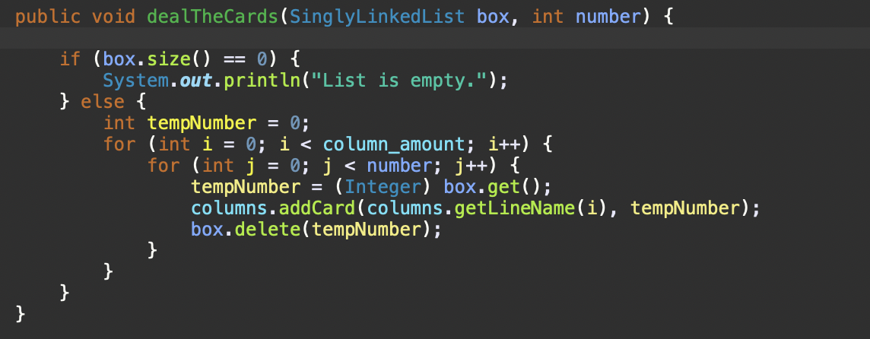
DealTheCards() Function
Randomly distributes cards using the random function. Each column limited with 6 at first dealing process with constants.

Slide 13




gameKeys() Function
Cursor shifts to the beginning or end of the columns, depending on the way when the cursor comes to edges. Player can cancel the selection from box and columns.

Slide 14
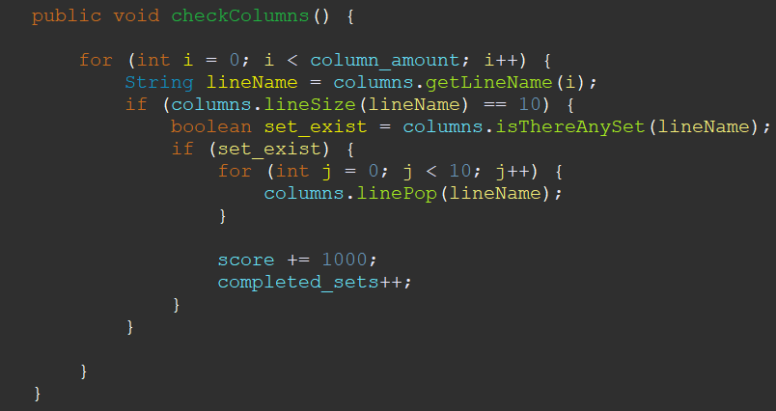
checkColumns() Function
As the numbers are transferred, the checkColumns function in Game class has been written to continuously check each column to check whether there is a set. If there is a set, the set is deleted.

Slide 15

printGameScreen() Function
In the gameplay, the selected number’s color is changed to red. Highlighted the back of the number, which the cursor is on, with red. If the player selects a number the last number of possible columns that can be transferred will be highlighted as green.

Slide 16

SCREENSHOTS

Slide 17
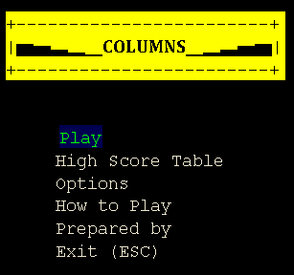
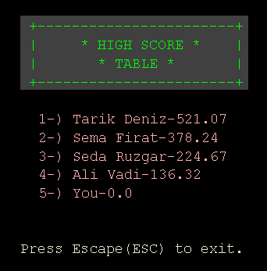
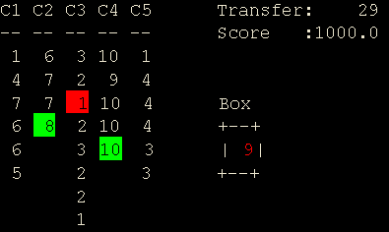
Main Menu
Game
High Score Table

Slide 18
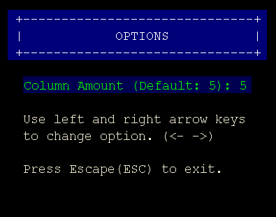
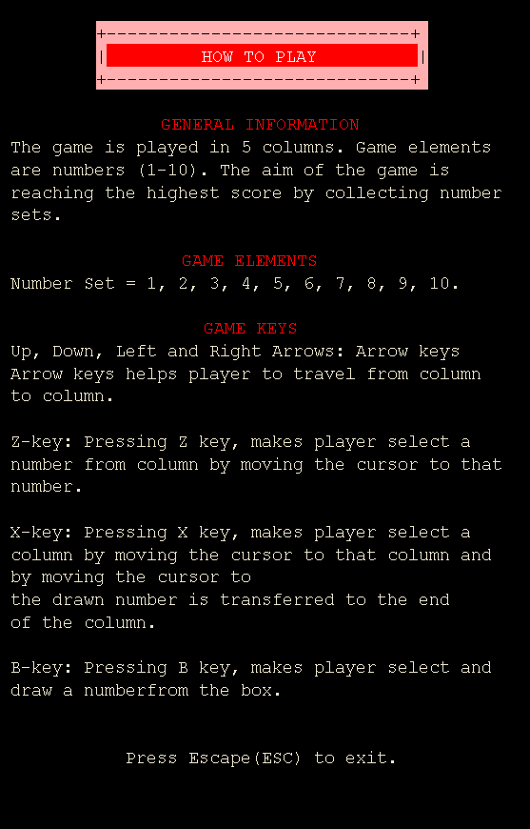
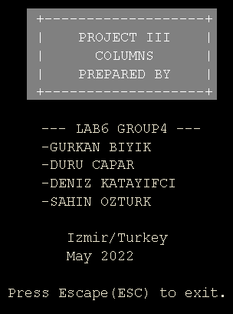
Options
How To Play
Prepared By

Slide 19

Conclusion
Columns project was an educational journey for our team.
The team worked with good communication, and we learned to work as a team.
Our team finished all tasks correctly, and fully functional.

Slide 20


References
1) https://howtodoinjava.com
2) https://java-programming.mooc.fi
3) https://stackoverflow.com

Slide 21

QUESTIONS?

